Slide 1
Adapting UI to different screens Developer’s Guide to Windows 10

Slide 2
Agenda
The Microsoft design language
How Windows makes design easier
What am I designing?
Adaptive UI Techniques
Adaptive UI Tooling
Visual States Triggers
Relative Panel

Slide 3
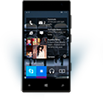

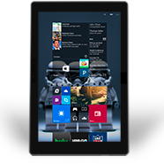
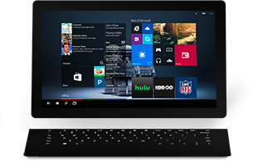

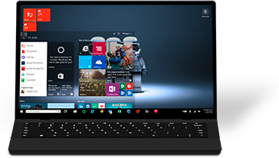

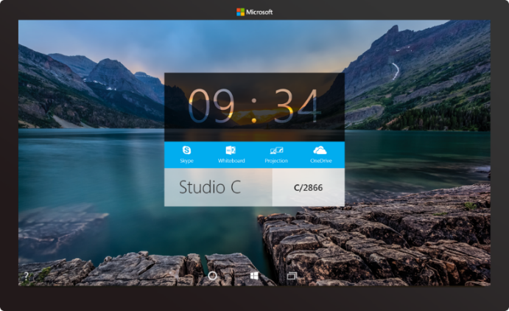

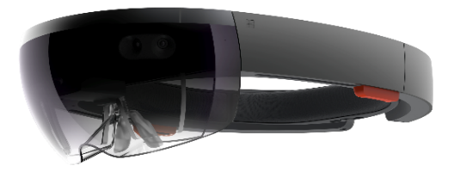
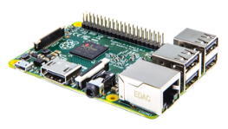

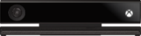
2-in-1s (Tablet or Laptop)
Classic Laptop
Desktops & All-in-Ones
Phone
Phablet
Small Tablet
Large Tablet
Windows 10
Surface Hub
Xbox
Holographic
IoT

Slide 4
UWP Design principles and adaptive UI features

Slide 5
We want you to use your design, fonts, icons etc… If you’re stuck, or need inspiration, we share our first party guidance that you can use

Slide 6
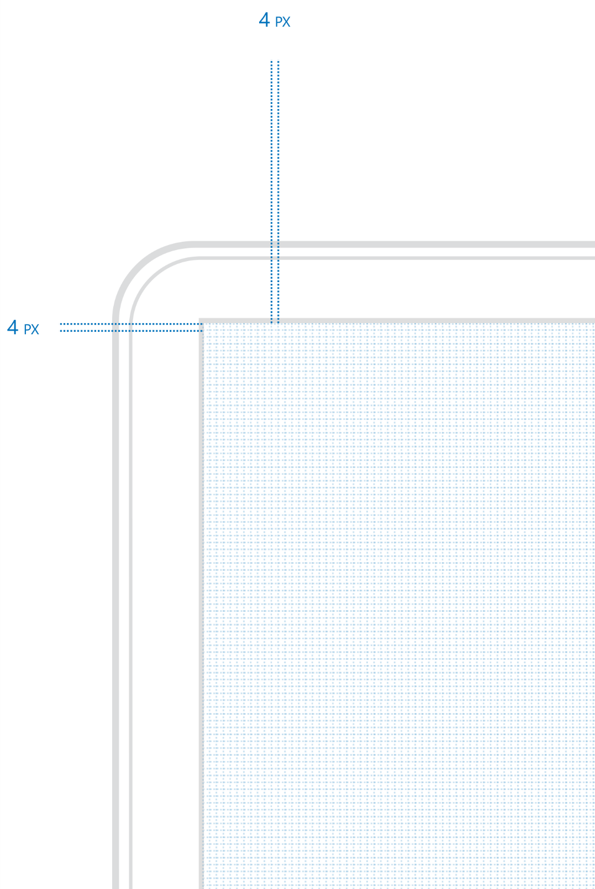
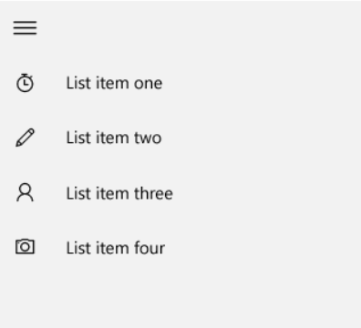
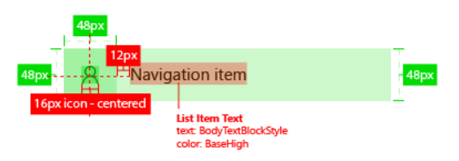
Four is the magic number

Slide 7


Adaptive controls

Slide 8


Input intelligence

Slide 9
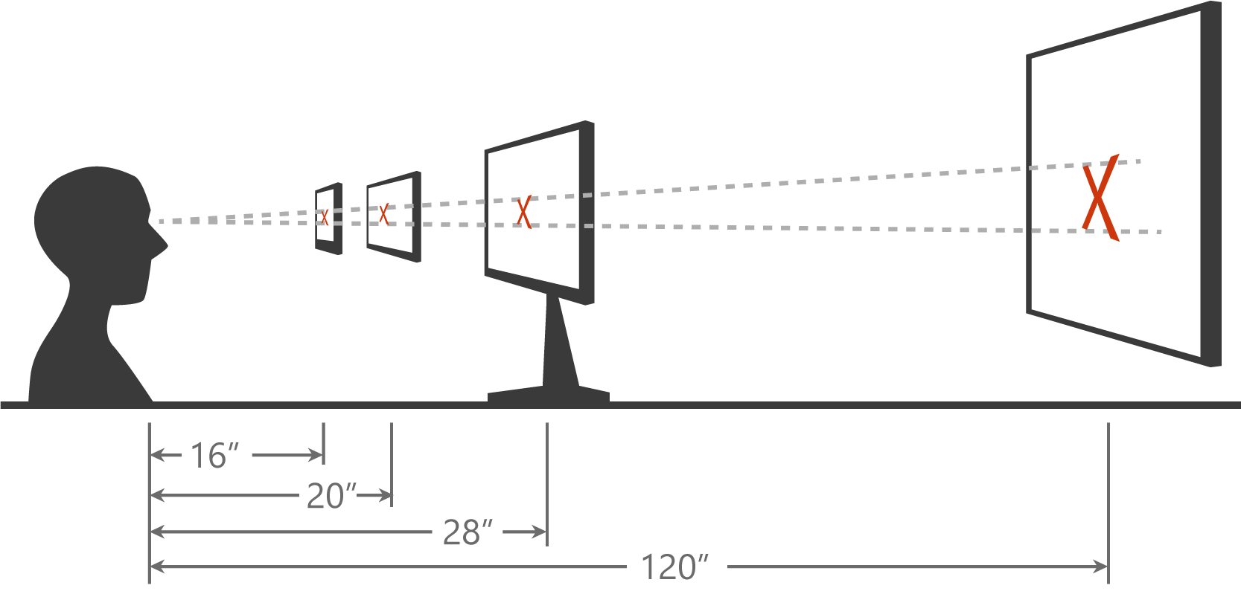
Scaling algorithm

Slide 10
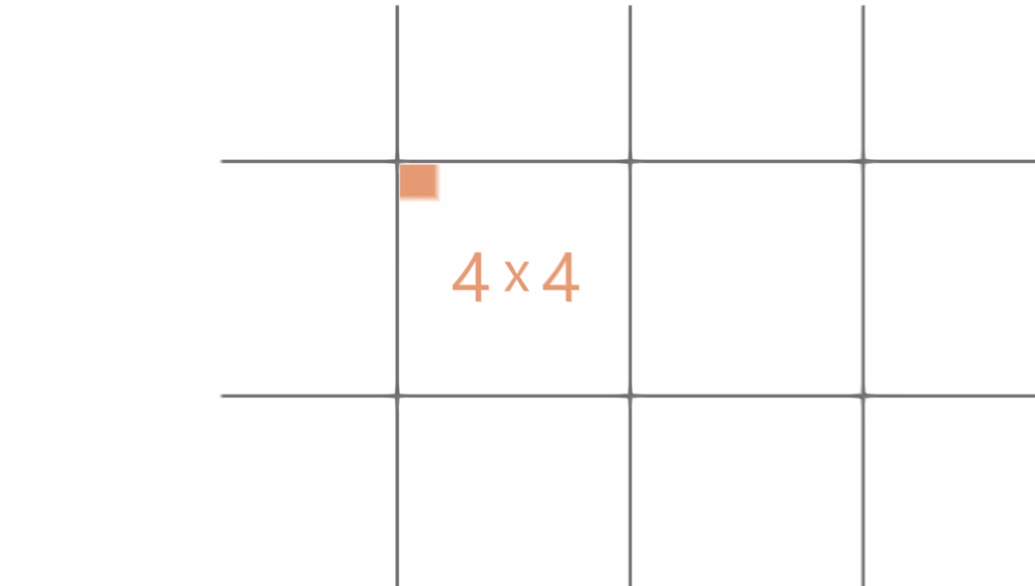

Slide 11
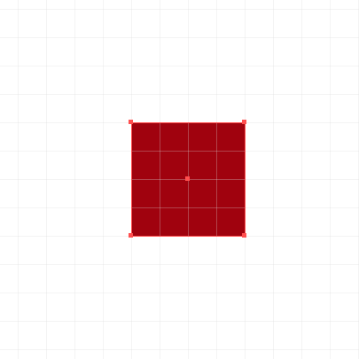
Effective pixel
Physical Pixel
Effective Pixel

Slide 12
Ignore scale, resolution, & dpi. Design in Effective Pixels XAML is already in Effective Pixels

Slide 13
What am I designing?

Slide 14
Planning your design
5”
8”
13”
Phone
Viewing Distance: 16.3”
Tablets and 2 in 1
Viewing Distance:
20”
Small and Large Laptops
Viewing Distance:
24.5”
Small and Large Desktop Monitors
Viewing Distance:
28”
TV
Viewing Distance:
84”

Slide 15
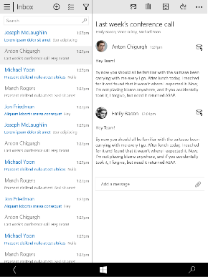
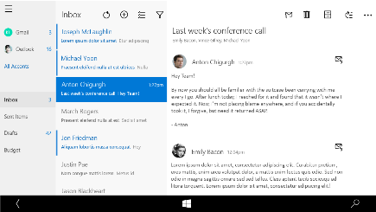
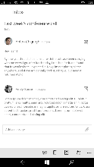
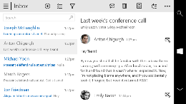
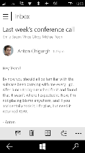
Snap points
epx
320
548
720
1024
phone
phablet & tablet
desktop

Slide 16
Demo: Calculator

Slide 17
As you design
Adapt to size change
Adapt to input change
Rely on the scaling algorithm

Slide 18
Design Techniques for Adaptive UI

Slide 19
Use standard responsive/adaptive design techniques
1
4
Reposition
Reveal
2
5
Resize
Replace
Reflow
3
6
Re-architect
Notes:
There are six well known responsive/adaptive design techniques that you can use to create a UI that will flow across different devices, and we have a bunch of new controls that will help make this painless.
For more information on these techniques take a look at design.windows.com.

Slide 20
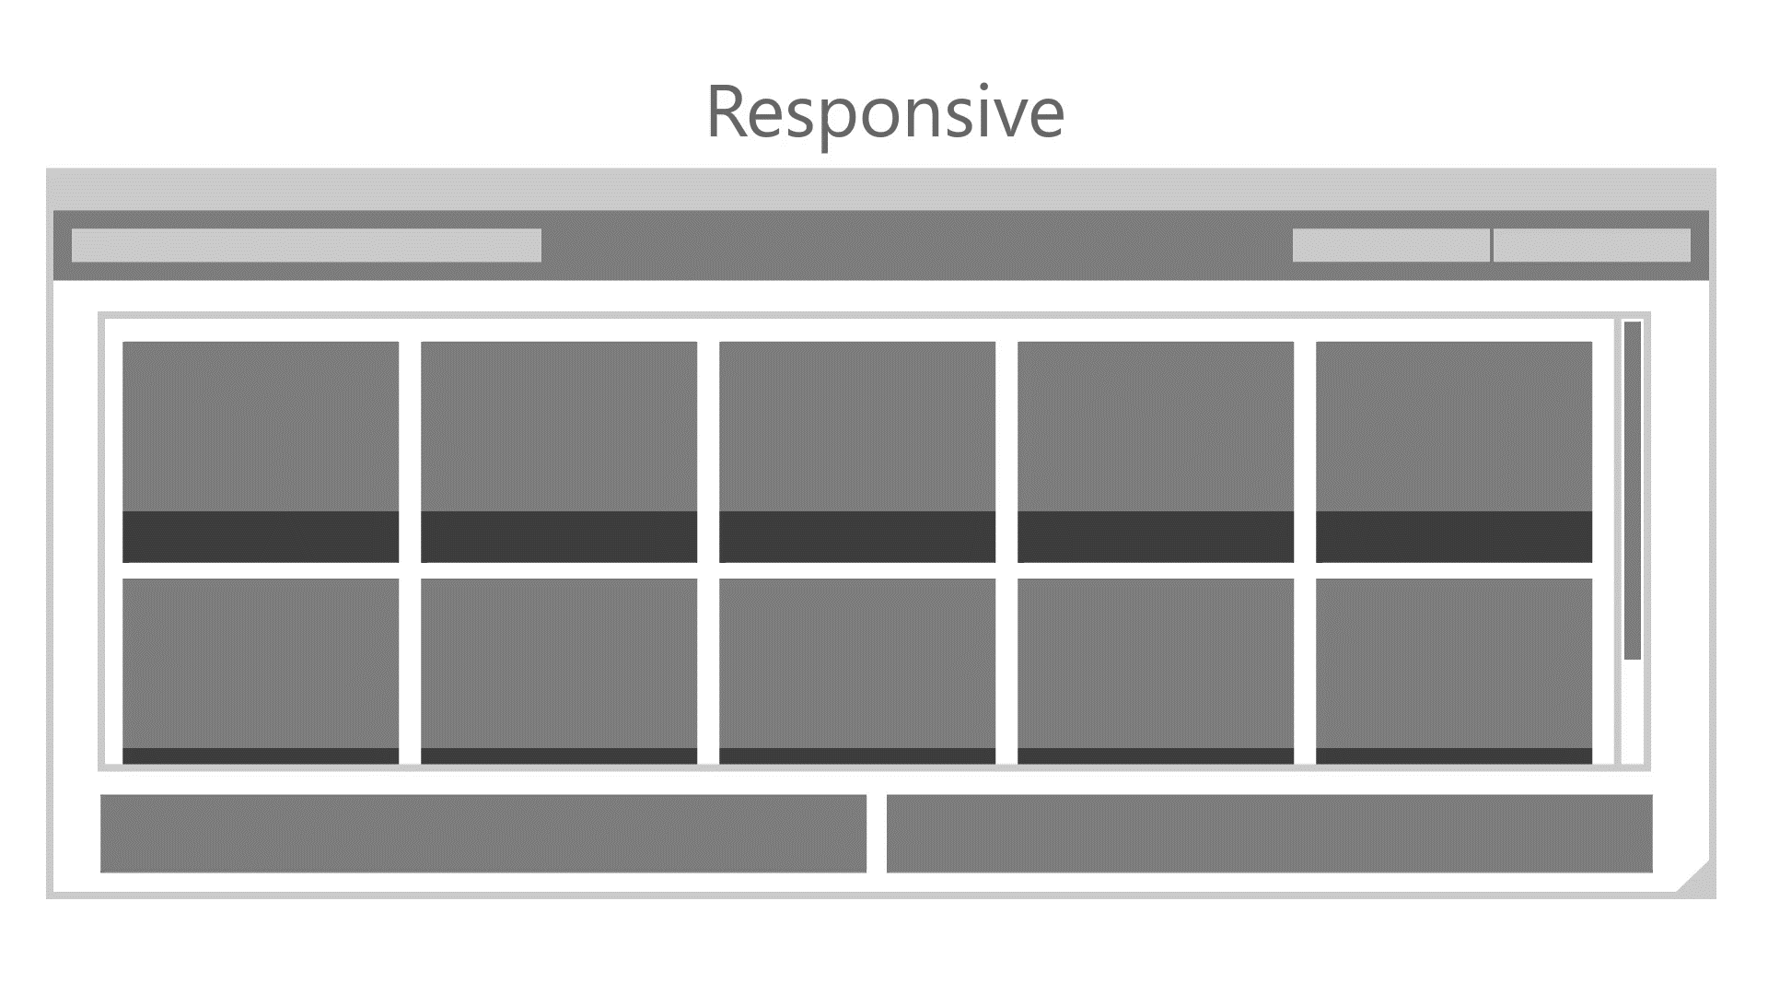

Slide 21
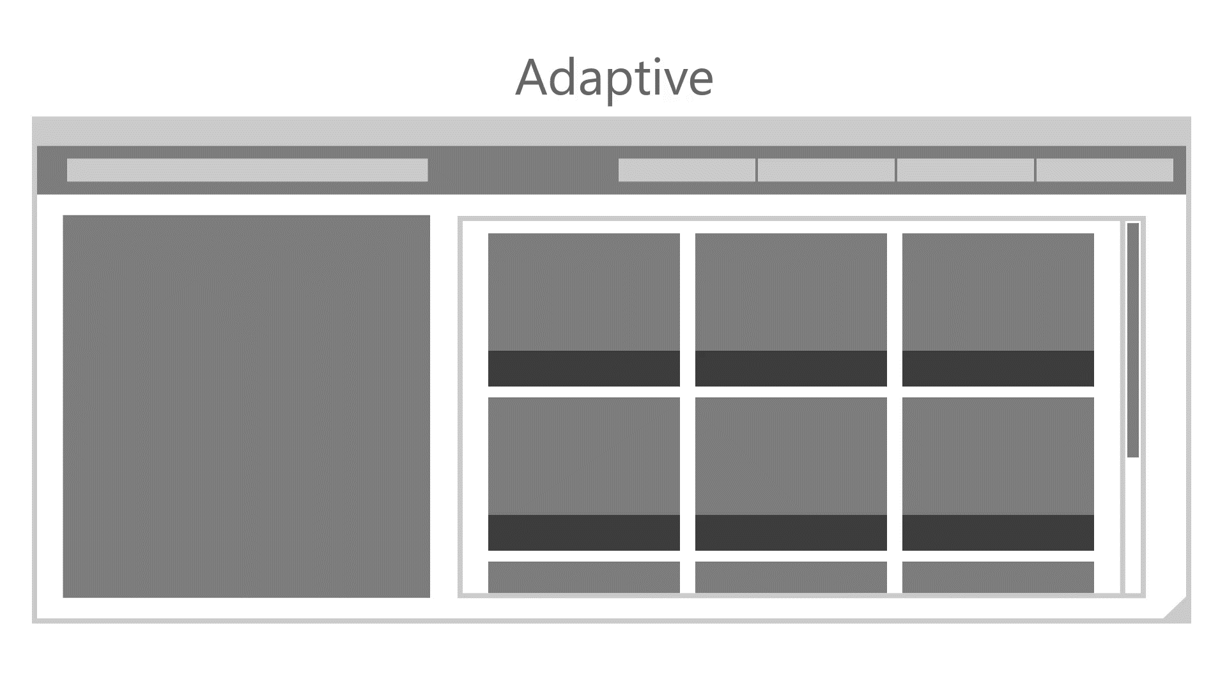

Slide 22
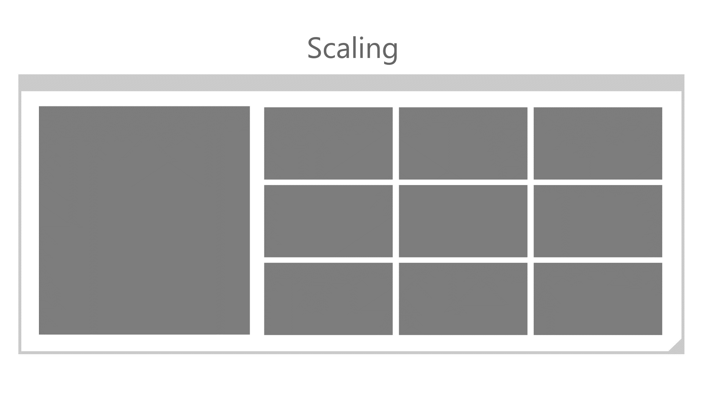

Slide 23
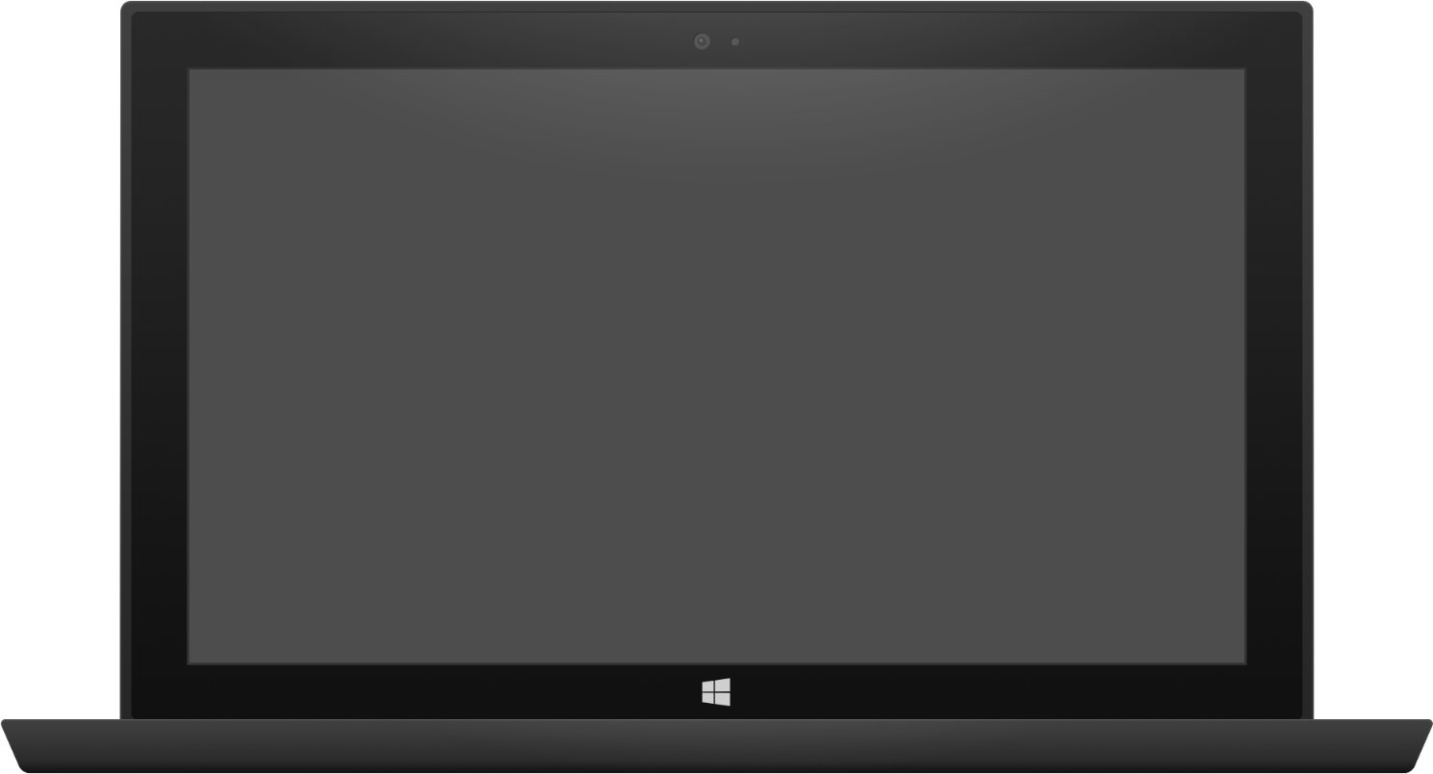
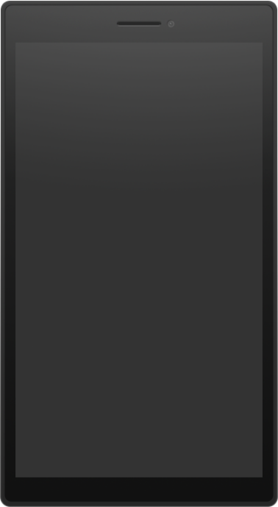
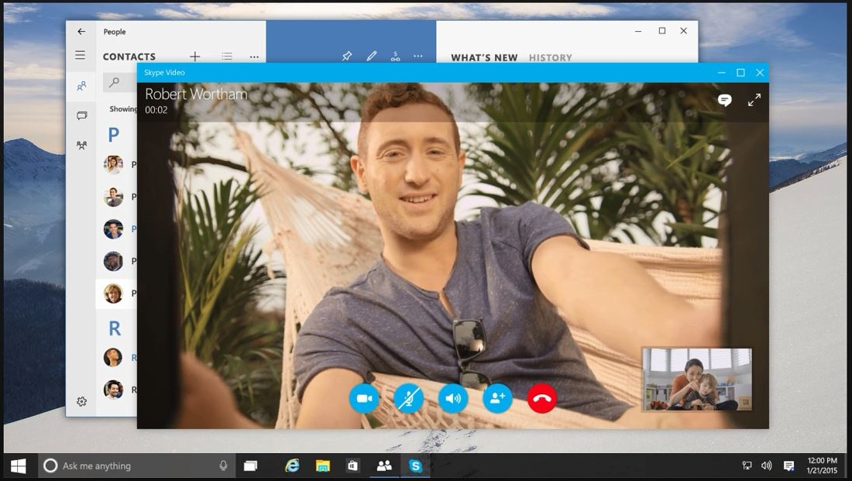
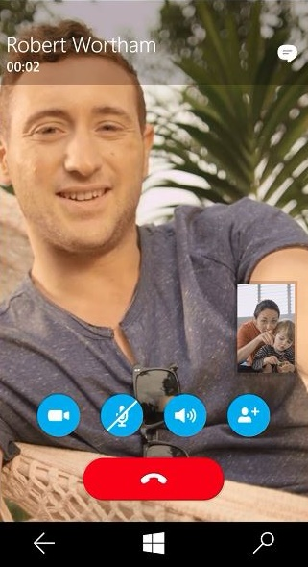
Adaptive design
Build a page that adapts to different screen sizes and orientations
Use Visual States and Adaptive Triggers to change layout
Use RelativePanel to position blocks of content relative to peers, re-positioning in different visual states
Tablet (landscape) / Desktop
Phone (portrait)

Slide 24
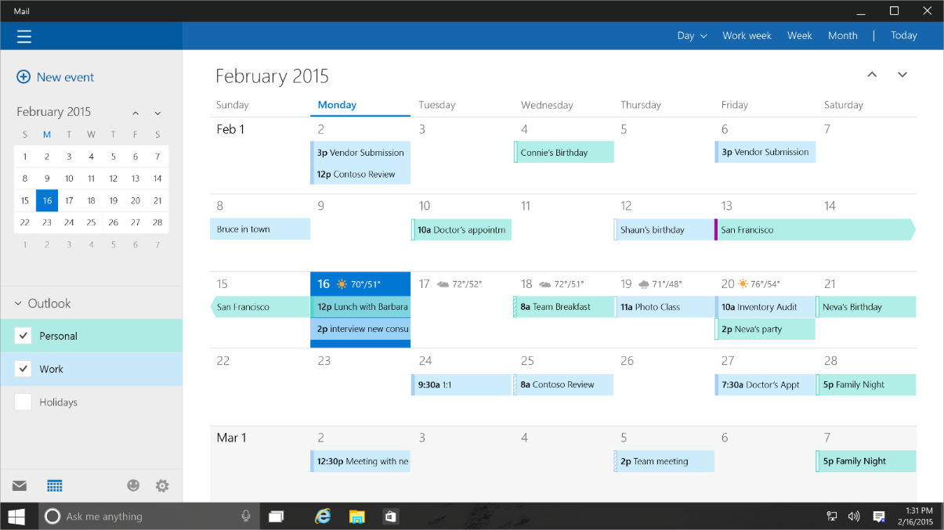
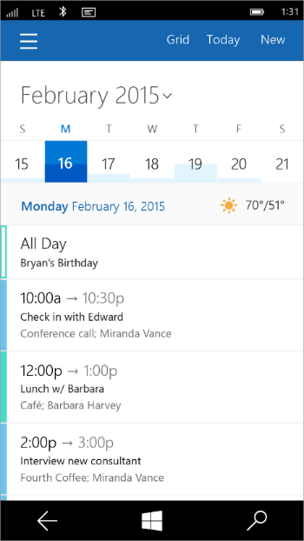
Tailored design
Build unique experiences on different devices
Tablet (landscape) / Desktop
Phone (portrait)

Slide 25
How to build an Adaptive UI

Slide 26
Visual States
Define XAML views
Unique layout for distinct states
Simplify animation
Automatically implement state transitions
Build in Blend
Design and preview states and transitions

Slide 27
Visual states allow you to define different selectable layouts that can be applied to your UI

Slide 28
How to set the visual state in code
VisualStateManager.Goto(element, state, transition)
public MainPage()
{
this.InitializeComponent();
this.SizeChanged += (s, e) =>
{
var state = "VisualState000min";
if (e.NewSize.Width > 500)
state = "VisualState500min";
else if (e.NewSize.Width > 800)
state = "VisualState800min";
else if (e.NewSize.Width > 1000)
state = "VisualState1000min";
VisualStateManager.GoToState(this, state, true);
};
}

Slide 29
Adaptive triggers
Code-free state transition
Two built-in triggers
MinWindowHeight (Taller than this)
MinWindowWidth (Wider than this)
<VisualState x:Name="VisualState500min">
<VisualState.StateTriggers>
<AdaptiveTrigger MinWindowWidth="501" />
</VisualState.StateTriggers>
</VisualState>

Slide 30
Adaptive triggers are a zero-code solution

Slide 31
Visual state setters
Setting a simple, scalar value
Great when you think of ENUM values like Visibility, Stretch, etc
Does not invoke a storyboard
Does not require ObjectAnimationUsingKeyFrames
<VisualState.Setters>
<Setter Target="MyText01.FontSize" Value="24" />
<Setter Target="MyImage.Stretch" Value="UniformToFill" />
<Setter Target="MyImage.Height" Value="150" />
</VisualState.Setters>

Slide 32
XAML's RelativePanel control
A child or two act as a anchor elements
They are relative to the panel
Other children are relative to the anchors
RelativePanel.Above = "ElementName"
RelativePanel.RightOf = "ElementName"
RelativePanel.Below = "ElementName"
RelativePanel.LeftOf = "ElementName"
RelativePanel simplifies adaptive UI
A simple Visual State setter can rearrange the UI
One element can move a family of related elements

Slide 33
Demo: Building an Adaptive UI

Slide 34
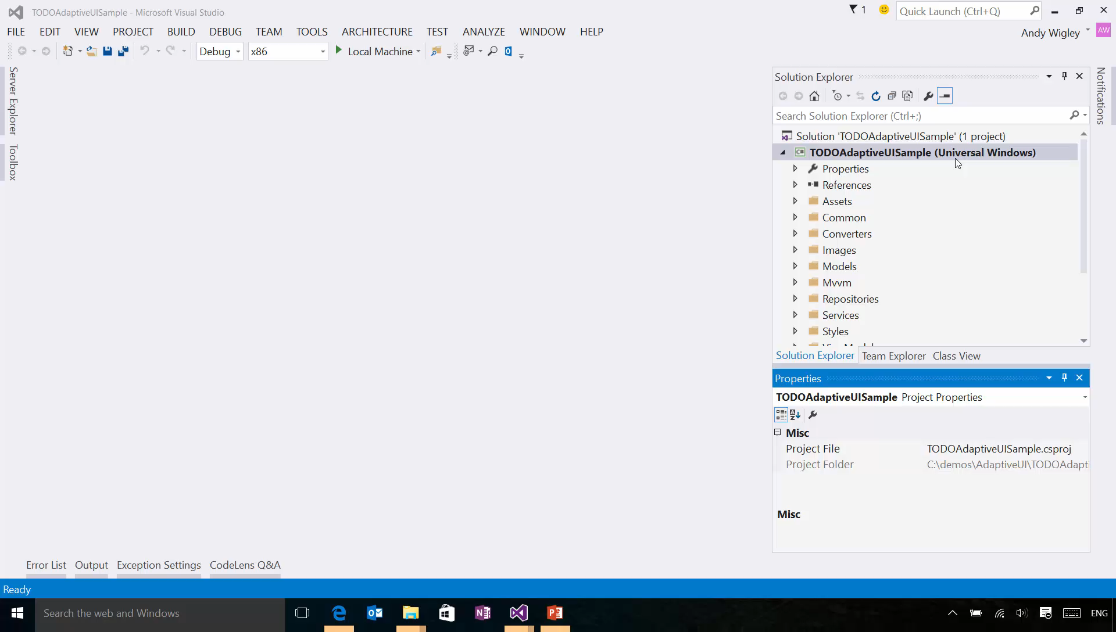

Slide 35
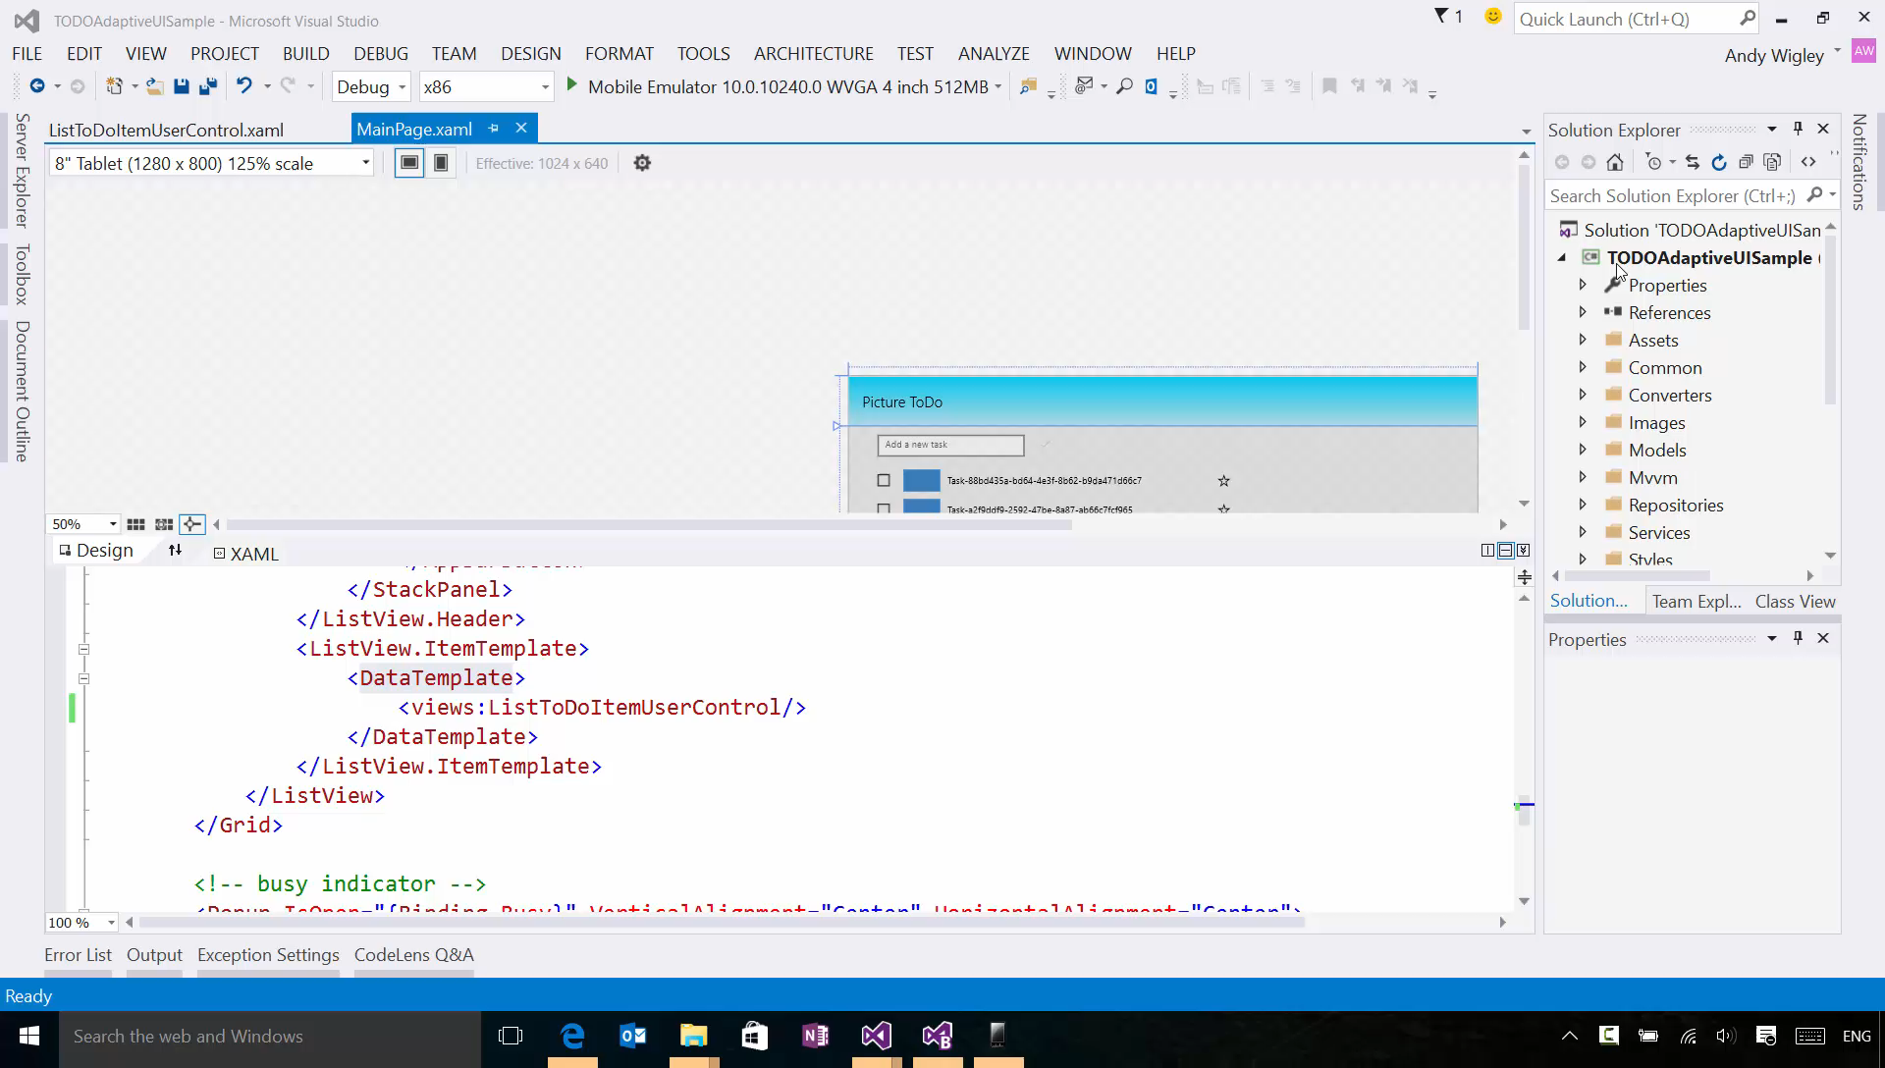

Slide 36
Custom triggers support your special scenarios

Slide 37
Custom adaptive triggers
Build to handle special cases.
public class DeviceFamilyTrigger : StateTriggerBase
{
private string _deviceFamily;
public string DeviceFamily
{
get { return _deviceFamily; }
set
{
var qualifiers = Windows.ApplicationModel.Resources.Core
.ResourceContext.GetForCurrentView().QualifierValues;
if (qualifiers.ContainsKey("DeviceFamily"))
SetActive(qualifiers["DeviceFamily"] == (_deviceFamily = value));
else
SetActive(false);
}
}
}

Slide 38
Demo: Custom adaptive triggers

Slide 39
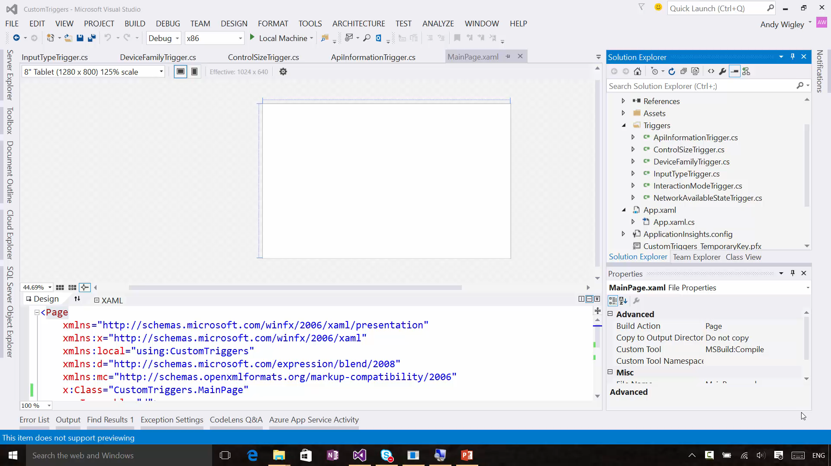

Slide 40
Building Tailored Views
Build unique experiences on different devices
One option: Build separate pages for individual families
Can interrogate resource qualifiers (from MRT) to determine the family
Option 2: Use XAML views
var qualifiers = Windows.ApplicationModel.Resources.Core .ResourceContext.GetForCurrentView().QualifierValues; if (qualifiers["DeviceFamily"] == "DeviceFamily-Xbox")
// optimized for games console
rootFrame.Navigate(typeof(MainPage_Xbox), e.Arguments);
else
rootFrame.Navigate(typeof(MainPage), e.Arguments);

Slide 41
Demo: XAML views

Slide 42
Developers have many tools to build an adaptive UI

Slide 43
Review
The Microsoft design language
How Windows makes design easier
What am I designing?
Adaptive UI Techniques
Adaptive UI Tooling
Visual States Triggers
Relative Panel

